Slide 1
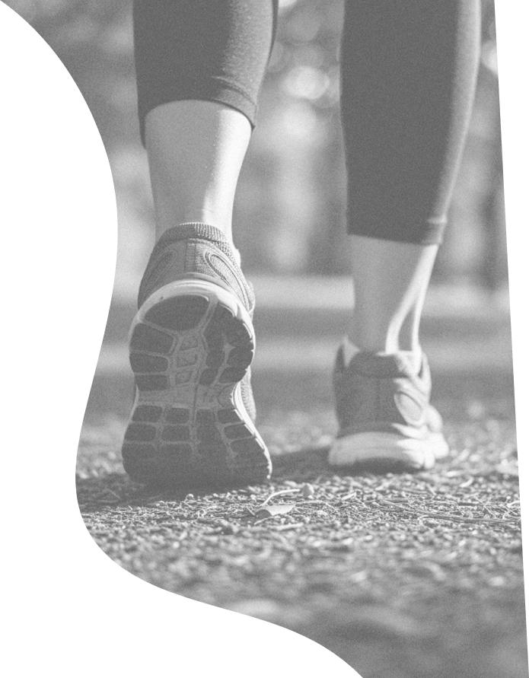
GroundWalks
Understanding the grounds we walk on through next-generation insole pressure sensors
formerly WalkSensePlace
Kristian Kloeckl (CAMD, urban interaction design)
Eric Folmar (Bouvé, physiotherapy and biomechanics)
Amy Lu (CAMD/Bouvé, health tech and communication)
RAs Samuel Greeman, Samantha Tracey, Catherine Zhou
Stappone (technology partner)
Notes:
Title. Swatches removed; surface colours still used throughout.

Slide 2
01
MOTIVATION
Walking…
One of the most accessible and sustainable forms of physical activity. No specialized equipment and minimal training required.
Regular walking improves cardiovascular health, boosts mood and cognitive function, aids weight management and metabolism, enhances joint mobility and strength, and lowers blood sugar and diabetes risk.
Notes:
Motivation, from the August deck. Walking as the most accessible physical activity; health outcomes it is associated with; the two framing quotes.

Slide 3
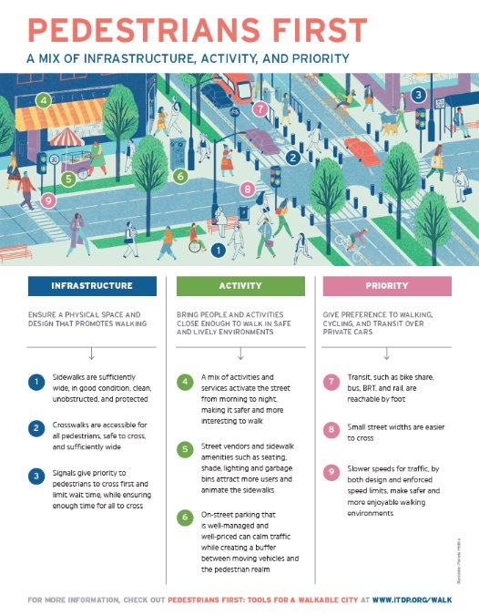





01
MOTIVATION
Walkable Cities Movement & Public Health
Walking can be integrated into daily routines. Even moderate increases in walking can yield significant health gains at the population level.
Walk Score, Walk Friendly Communities, Walkable Winston-Salem, Natural Walking Cities and Boston Walking City Trails all rate places by how well they support walking.
Pedestrians First frames it as a mix of infrastructure, activity, and priority: ensure a physical space and design that
promotes walking; bring people and activities close enough to walk in safe and lively environments; and give preference to walking, cycling, and transit over private cars.
Notes:
Motivation. Walkability is now a design and policy target, but existing measures (Walk Score, Walk Friendly Communities, Pedestrians First, Boston Walking City Trails) score proximity and infrastructure from map data, not the ground itself. Sets up the GIS-unreliability slide later in the deck.

Slide 4

01
MOTIVATION
Feet as dynamic interface
between the human body and urban ground
What if just by walking we could better understand
HUMAN BODY
1
how ground conditions change for urban walkers
2
how they impact human health and experience
3
how this information can inform the design of urban spaces
URBAN GROUND
Notes:
Motivation. The foot as the interface between body and urban ground, and the three 'what if' questions that became the project objectives on the next slide.

Slide 5
02
OBJECTIVES
What GroundWalks sets out to explore
GroundWalks leverages next-generation insole pressure sensors to understand the grounds we walk on, the human experience of walking in cities, and its impact on health and urban design.
1
CORE
2
CORE
3
EXPLORATORY
Detecting ground conditions
Walking & health
Toward walkability
How can different ground conditions be detected from the data the insoles capture?
How do the various surfaces we walk on affect our health — mental and physical?
How might the data and models be used to improve urban walkability?
Notes:
Three project objectives. #1 is the modelling focus; #2 and #3 are broader/exploratory.

Slide 6
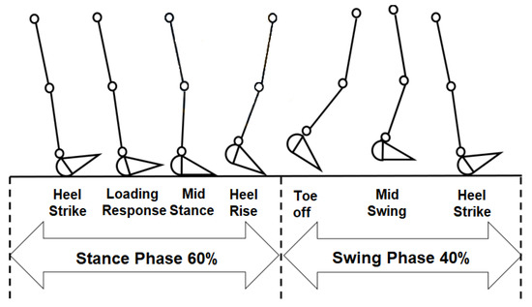
03
BACKGROUND
The gait cycle and gait events
A gait cycle runs from one heel strike to the next. For roughly 60% of it — the stance phase — the foot is on the ground, moving through loading response, mid stance and heel rise before toe off. The remaining 40% is swing, when the foot travels forward and carries no load at all.
Because pressure registers only during stance, that window is where every feature comes from. Feature constructing at the nexus of physiotherapy, urban design and public health draws on the accelerometer impact peak at heel strike and the loading rate that follows it, pressure distribution entropy during mid-stance, the spectral energy ratio between high and low frequencies, and the step-to-step variability of each measure across a walk.
Figure 1, “The gait cycle and gait events” — Aqueveque, Germany, Osorio & Pastene, Sensors 2020, 20(3), 656 (CC BY). mdpi.com/1424-8220/20/3/656
Notes:
Background. The gait cycle: stance ~60%, swing ~40%. Maps each gait event onto the features the models use. Add the source citation for the diagram.

Slide 7
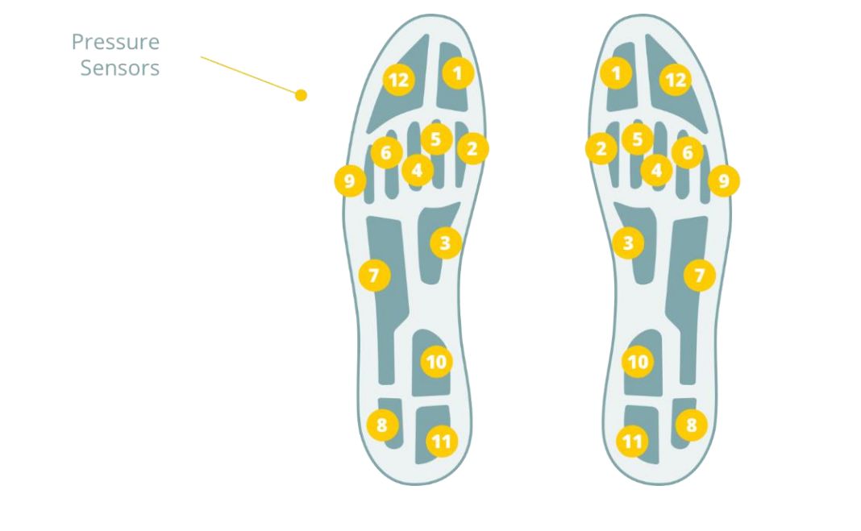
04
THE INSTRUMENT
A pressure-sensing insole (stappone)
What each sole carries
Each sole carries twelve pressure pads that record the shape of the load through every step as sensors sv1–12, alongside an accelerometer and gyroscope picking up impact, vibration and foot rotation while the foot is down. The walk is written to on-board memory as it happens, then synced over Bluetooth LE to the app afterward.
12 pressure sensors per foot
Notes:
Condensed: dropped the resolution row and footnote. Diagram is the manual pressure-sensor layout (Screenshot 152305).

Slide 8
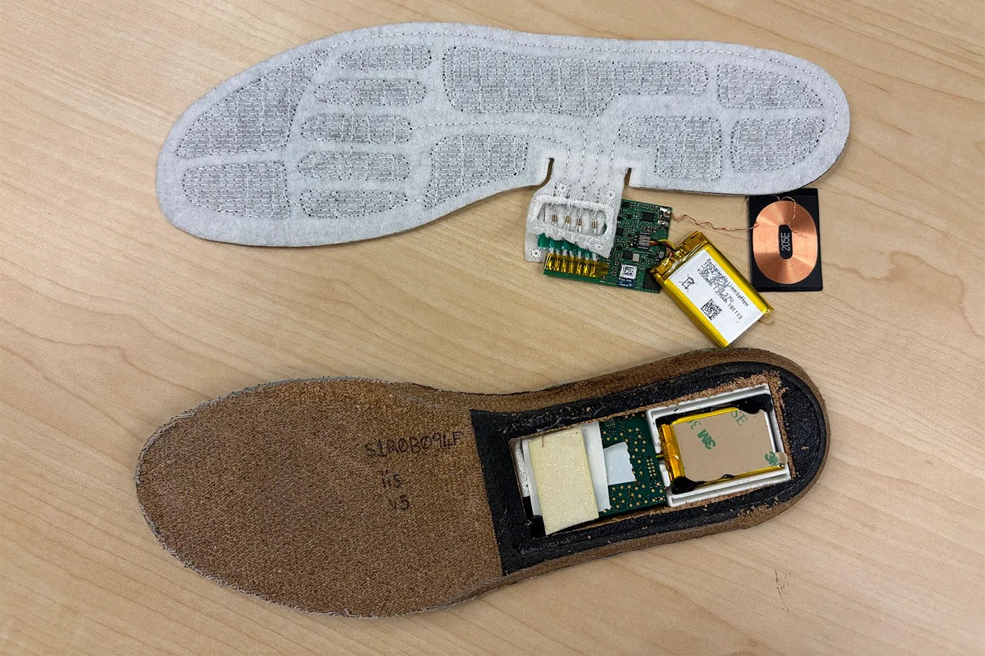
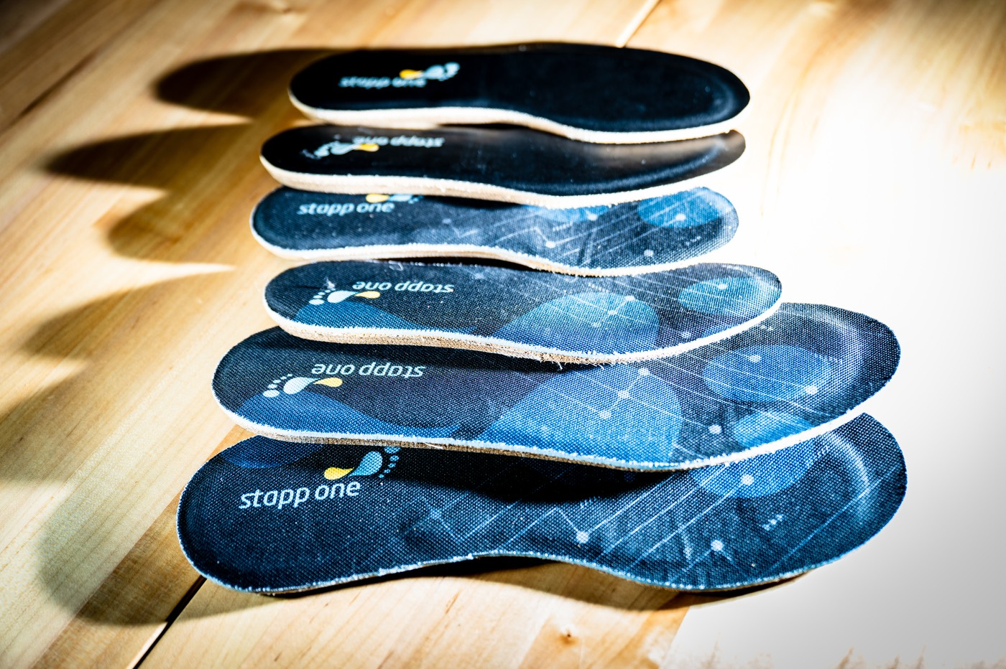
Wearable Insole Pressure Sensors
100Hz sampling
12 pressure zones (resistive fabric)
Bluetooth
Wireless Charging
IMU (accelerometer, gyroscope, magnetometer)
Battery
Technology Partner: Stappone

Slide 9
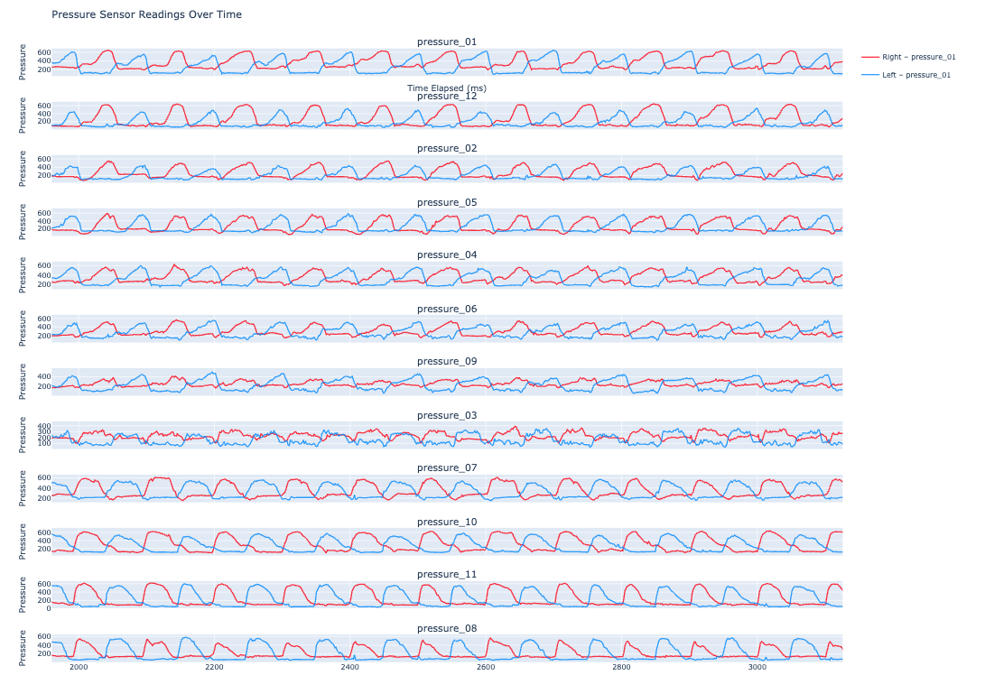
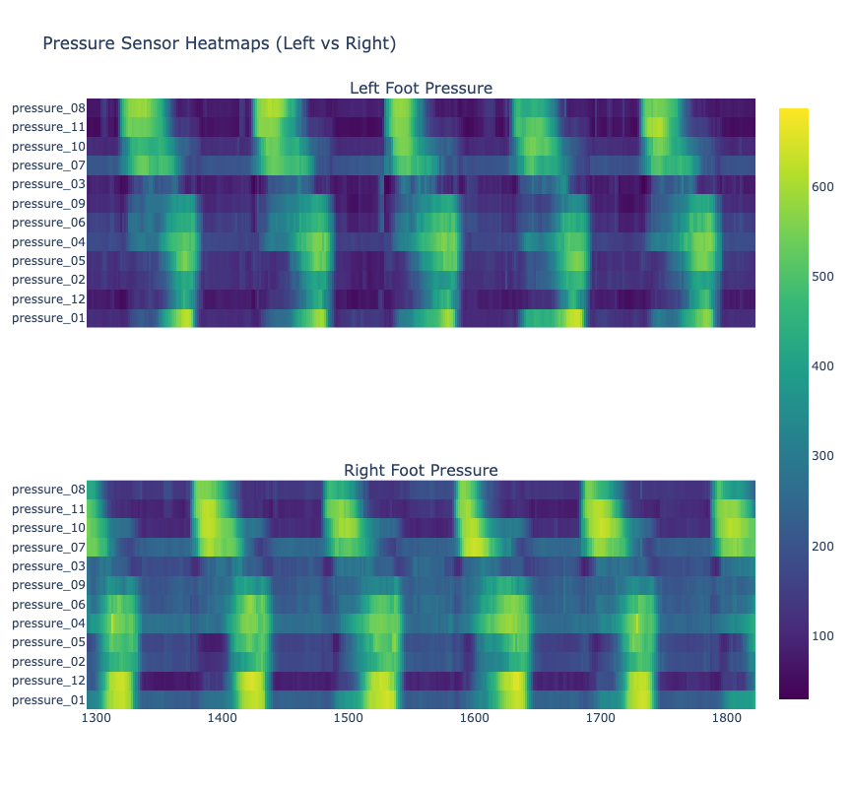
04
THE INSTRUMENT
From footstep to data
Each step is recorded on the insole as 12 pressure channels + IMU, synced over Bluetooth, then exported as CSV (sole_id, timestamp, sv1-12, acc_x/y/z).
pressure over time — left (blue) vs right (red), one panel per sensor
per-sensor pressure heatmap across the recording
Notes:
Real recorded signal replaces the abstract flow. Left = per-sensor pressure lines L/R; right = pressure heatmaps. Shows the periodic gait signal the models read.

Slide 10
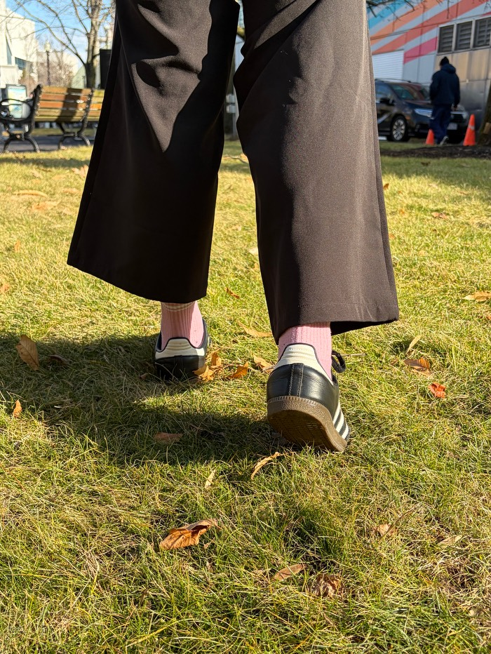
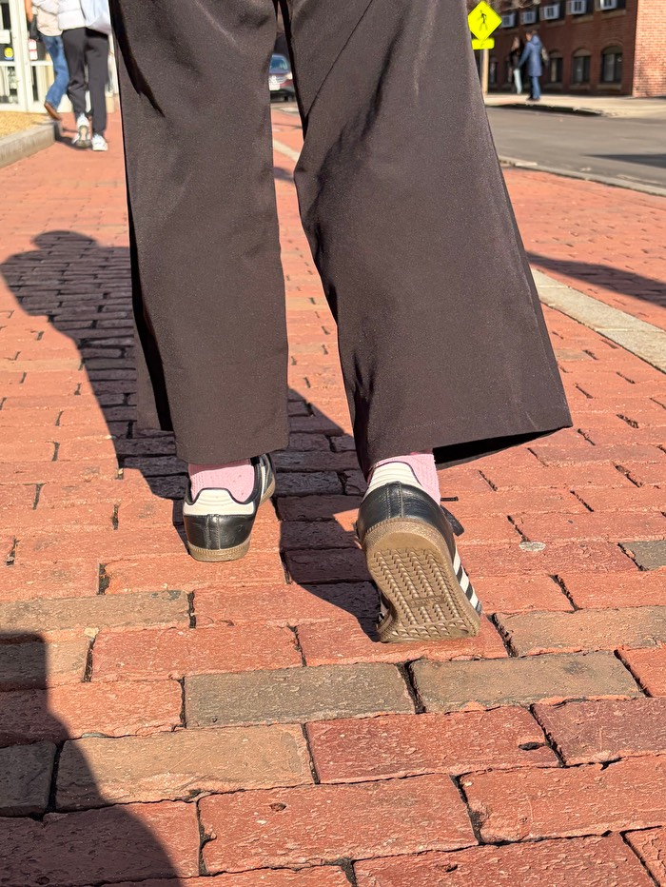
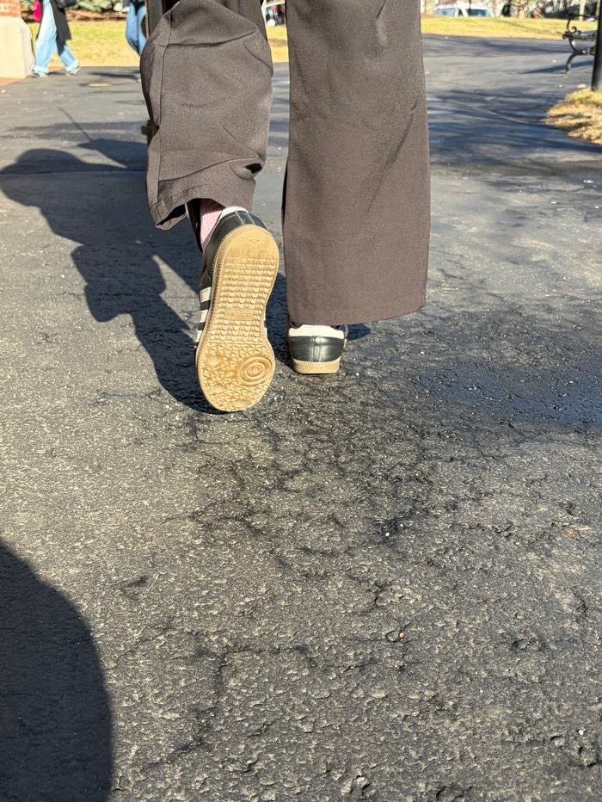
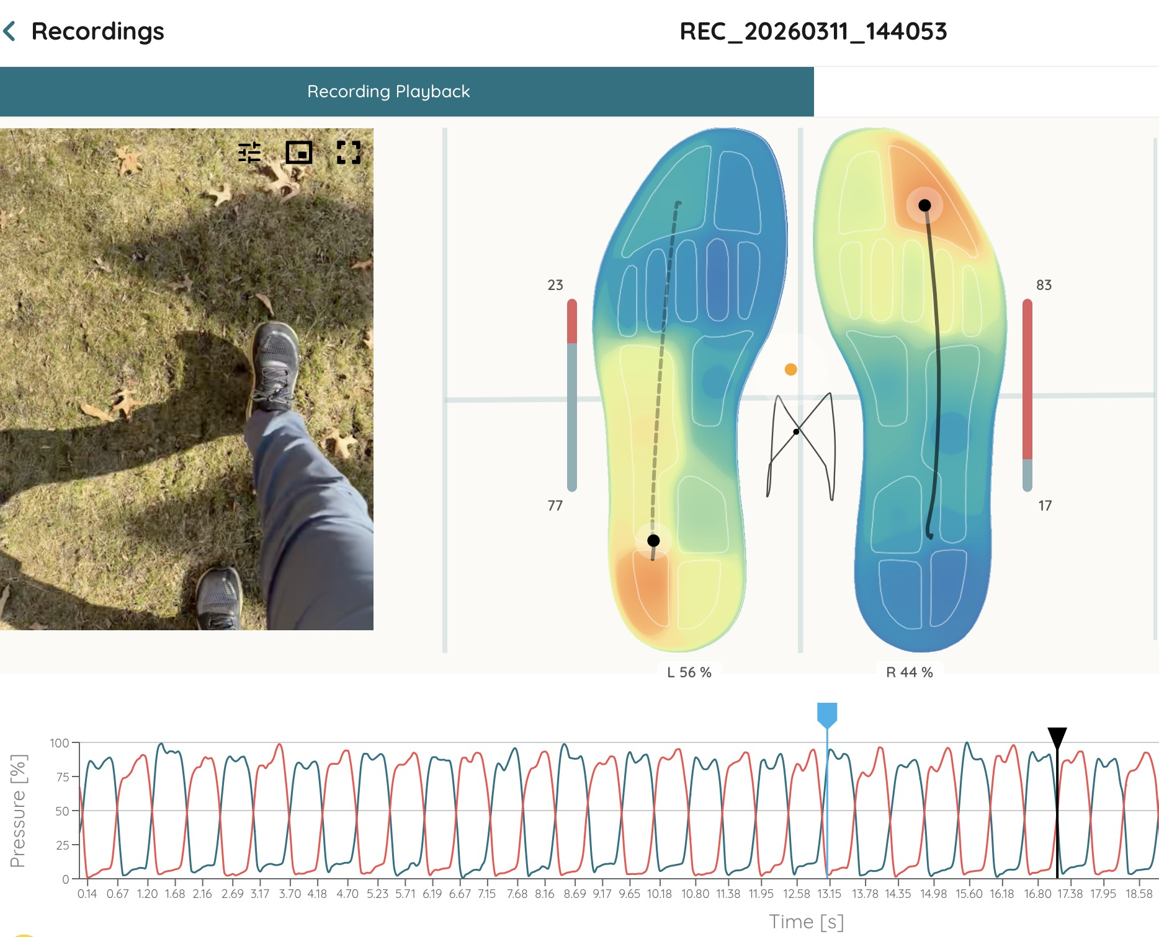
Data Collection while walking
on different ground conditions

Slide 11
05
DATA COLLECTION
The walk protocol
Before
log weather + start location; check the pressure map responds accurately
Four surface classes today
paved concrete, asphalt, even brick (continuous paved)
3-5 min over multiple surfaces in 2-3 clean sections; avoid drains, manholes and crosswalk pads; don’t switch surface every step
loose dirt and compact ground (light gravel + dust)
During
grass natural grass
note shoe model, end location, and any stops or irregularities
modular cobblestone, uneven brick — new, collecting
After
Notes:
Taxonomy updated: paved currently includes even + uneven; planned 4th modular-paved class for brick/cobblestone, plus sand/rocks. Footnote removed.

Slide 12
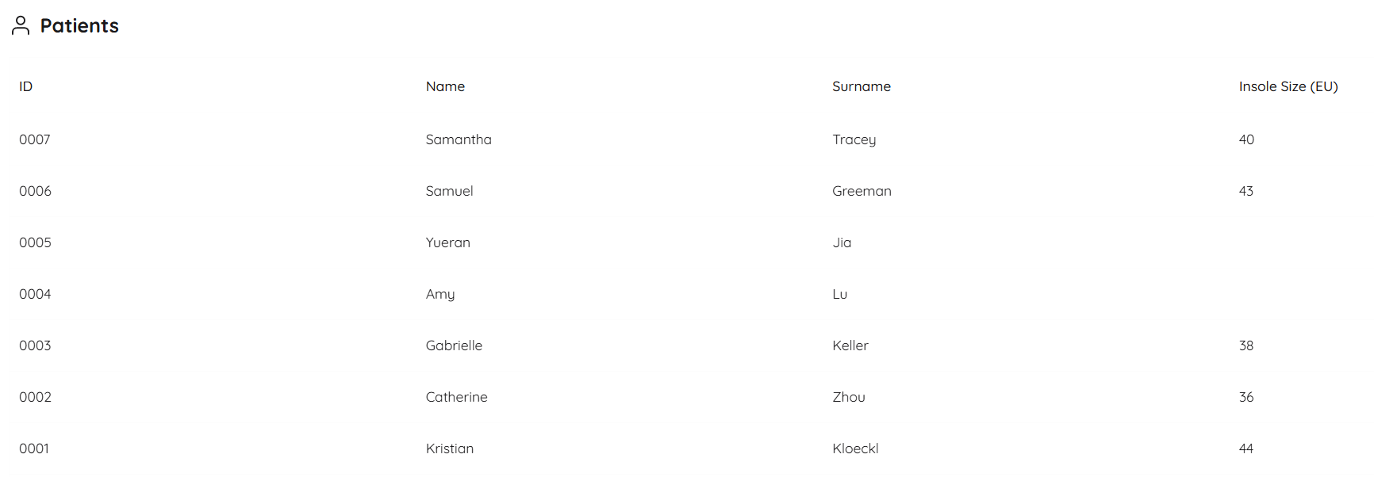
05
DATA COLLECTION
Walks Recorded: 144
Steps: ~40,000
Collection Period: February 2026 to present

Slide 13
05
DATA COLLECTION
The dataset so far
15,674
labelled steps collected to date
The set now covers four walkers — Kristian, Sam, Catherine and Samantha — across four surface classes including the new modular-paved (cobblestone/uneven brick), which is early in collection.
Notes:
Three walkers now: Kristian 5,902; Sam 6,153; Catherine 1,098 (grass 187/loose 57/paved 854). Total 13,153. Cadence note removed; growth note explains the 4th class + new surfaces + Samantha.

Slide 14
06
MODELS
Five models, one shared signal
Every model chooses from the same set of per-step features — the shape, timing, impact and vibration of one stride. Three are supervised classifiers; two turn the signal into a continuous 0-100 score.
grass · loose · paved
3-class surface supervised
soft · hard
2-class compliance supervised
Predicts the surface type of each step.
Collapses to the axis the sensor reads best.
0-100 score
Evenness unsupervised
P(firm) × 100
Hardness supervised
How regular the gait is, built with no labels.
How firm the surface is, from a logistic model.
cont · mod · loose · grass
4-class surface supervised · early stage
Splits paved into continuous vs modular (cobblestone). In data collection — early results.
Notes:
Four models share one step-feature extractor. Evenness = unsupervised scoring model; hardness = supervised P(firm).

Slide 15
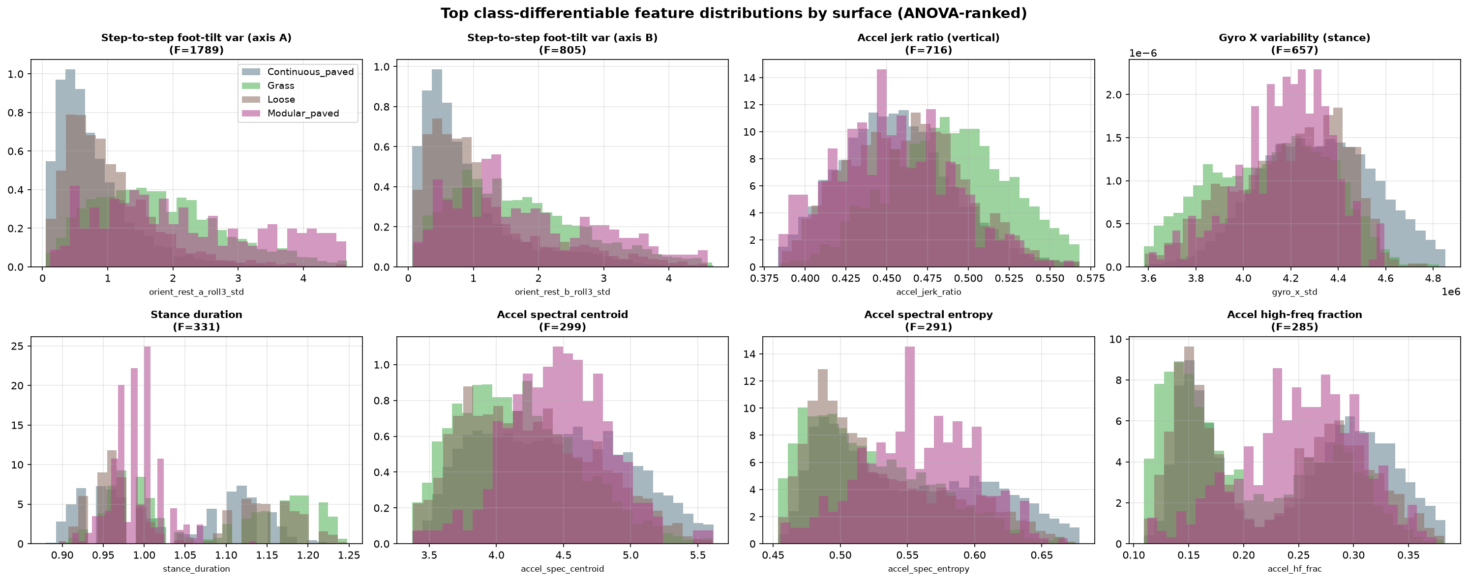
06
MODELS
What separates the surfaces
Each stride becomes ~48 features, and every model selects from that shared set — the 3-class model uses 36, the 2-class model uses 28, and the 4-class model is still in data collection. Ranked by how well they separate the surfaces, the strongest are step-to-step foot-tilt variation, accel jerk and gyro variability — grass (soft) sits apart from firm ground on almost all of them.
top class-differentiating features (ANOVA-ranked) — all four surface classes
Notes:
feature_distributions.png (grass/loose/paved). Explains the basis the classifiers learn from. Swap for the hard/soft version if you prefer.

Slide 16
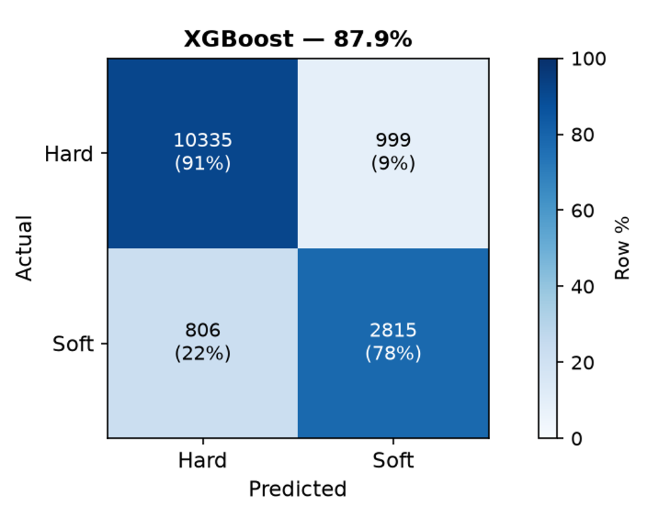
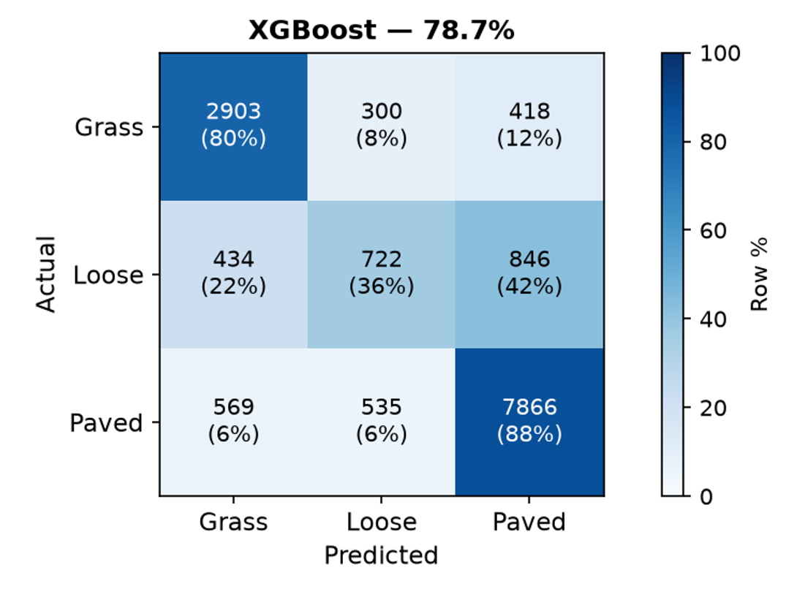
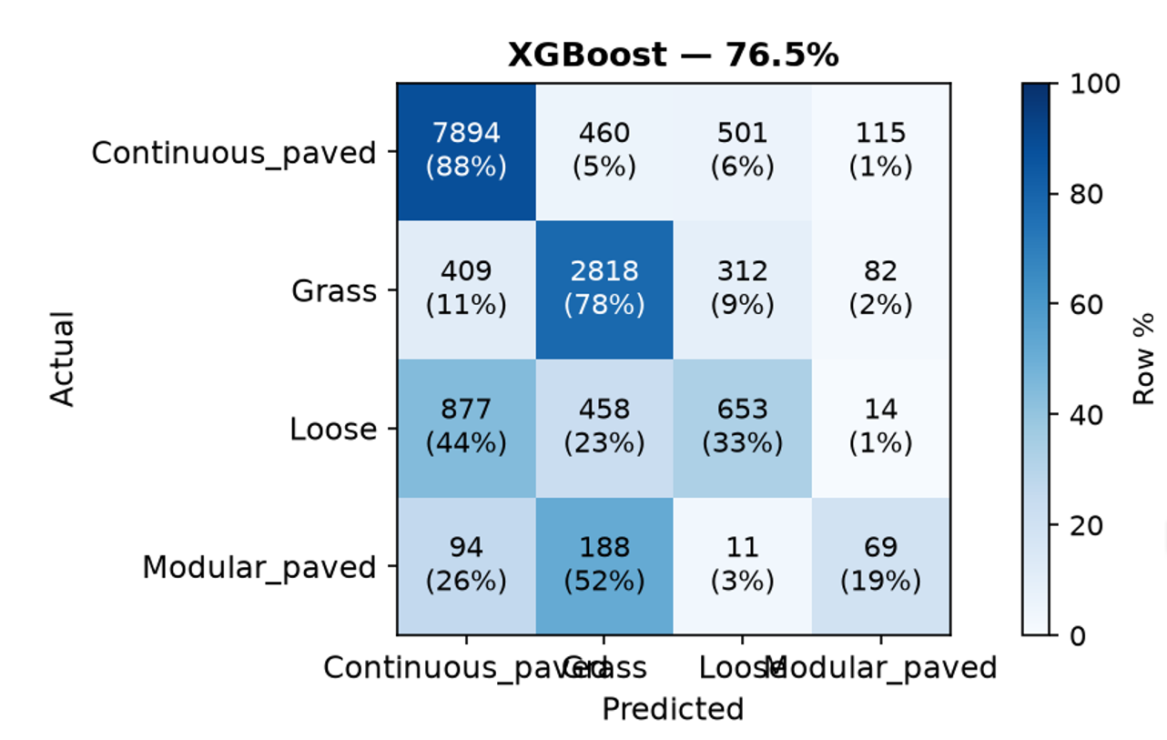
06
MODELS
How well the models separate surfaces
2-class · soft vs hard — 87.9%
3-class · grass/loose/paved — 78.7%
4-class · +modular paved — 76.5% (early)
Soft vs. hard is the robust split
Loose is the hard case
Modular paved is new & early
88% — the sensor reads how the ground gives.
only 36% of loose steps are correct; most are mistaken for paved — the two firm surfaces overlap.
the 4-class model splits out cobblestone/uneven brick; only 19% correct so far — data collection ongoing.
Notes:
Confusion matrices explain model performance. 2-class 89%; 3-class 79% with loose confused with paved (34% correct). Brick-as-own-class history added. These reinforce that firm-vs-firm is the hard split.

Slide 17
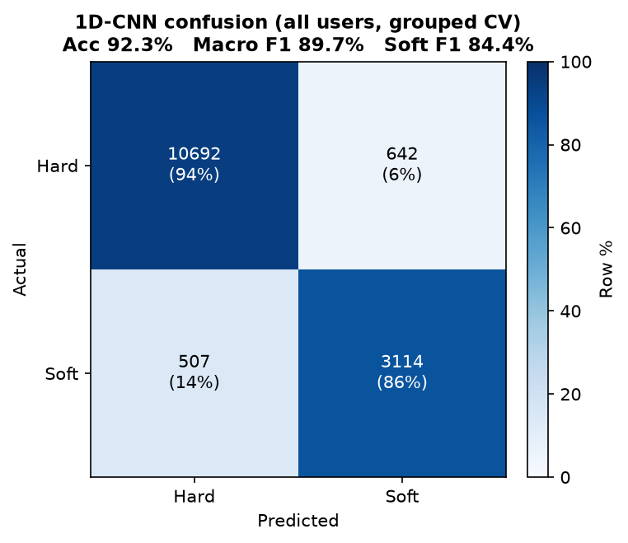
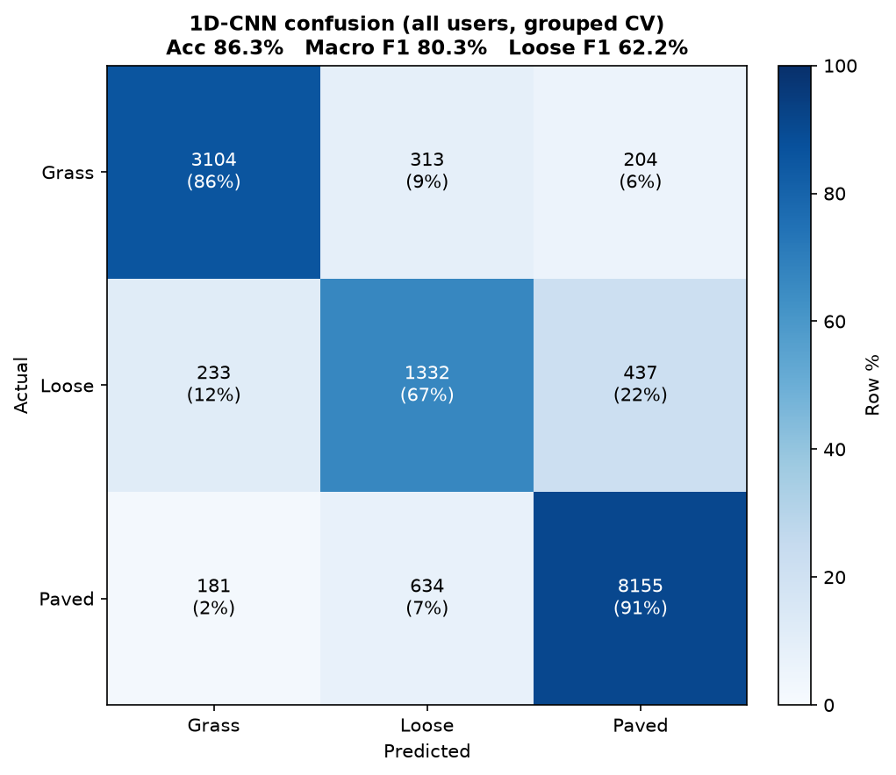
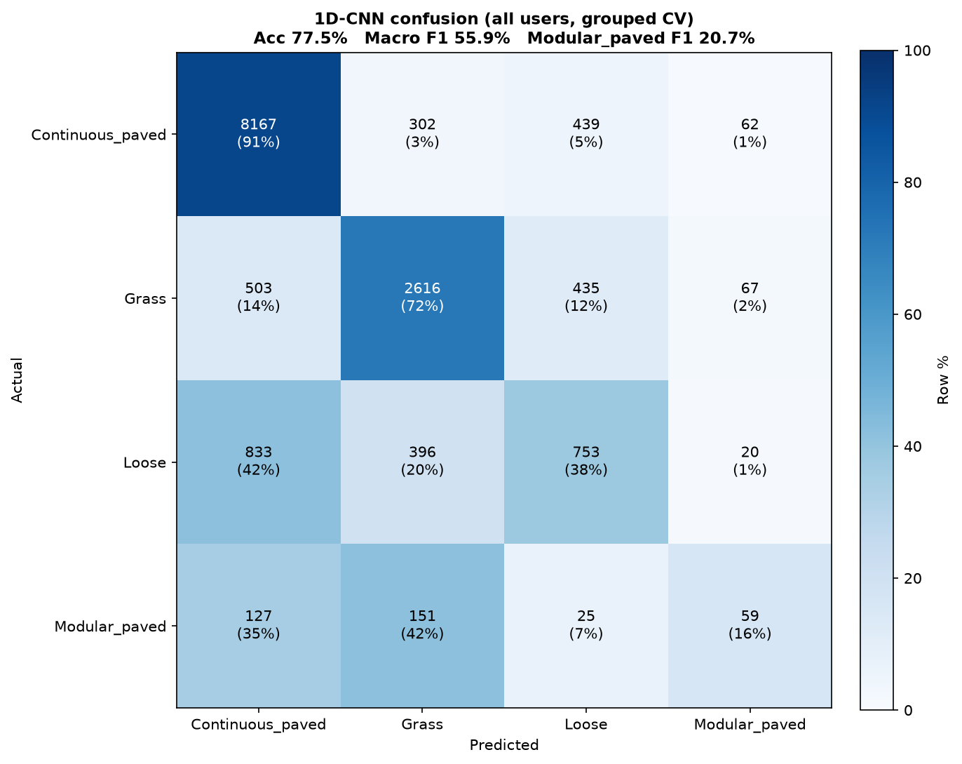
06
MODELS
The same tasks with a 1D-CNN
2-class CNN · soft vs hard — 92.3%
3-class CNN · grass/loose/paved — 86.3%
4-class CNN · +modular paved — 77.5% (early)
CNN is an alternative to XGBoost
Not directly comparable to XGBoost
Modular paved is new & early
A 1D-CNN reaches similar or better scores on the same step features.
CNN numbers use grouped (leave-user-out) CV; the XGBoost figures do not, so the accuracies are not head-to-head.
loose still confuses with paved and modular paved is data-starved — the CNN does not fix these.

Slide 18
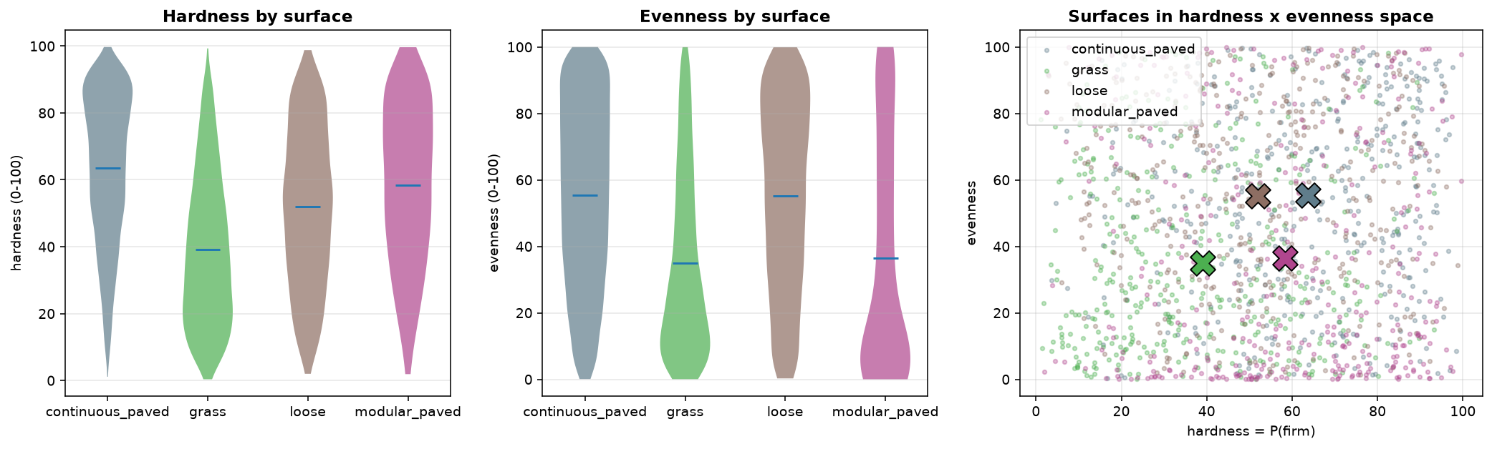
06
MODELS
Scoring smoothness: evenness & hardness
per-surface hardness & evenness, and the two scores together
Evenness (unsupervised) and hardness (supervised P(firm)) score each step 0-100. Grass is soft and uneven; firm surfaces score higher on both — but paved and loose overlap, the same limit the classifier hits.
Notes:
scales_populations.png (grass/loose/paved). Evenness + hardness by surface + scatter. Paved/loose overlap visible.

Slide 19
06
MODELS
Map data is an unreliable guide to the ground
Why the map falls short
48%
Land cover is canopy-blind: it sees the tree tops rather than the path underneath. Sidewalk material comes in broad codes, with large “unknown” gaps wherever a route leaves the sidewalk grid. And the city layers lag real conditions by years, so even a surface that is recorded correctly may no longer be the surface that is there.
of steps where the GIS map agreed with the ground truth on one walk
So the map can’t stand in for measured ground type — the case for instrumented walking.
Notes:
Reframed: GIS/map data unreliably predicts ground type. 48% agreement from the per-walk map. Bullets: canopy-blind land cover, coarse material codes + unknown gaps, stale data. Motivates measuring.

Slide 20
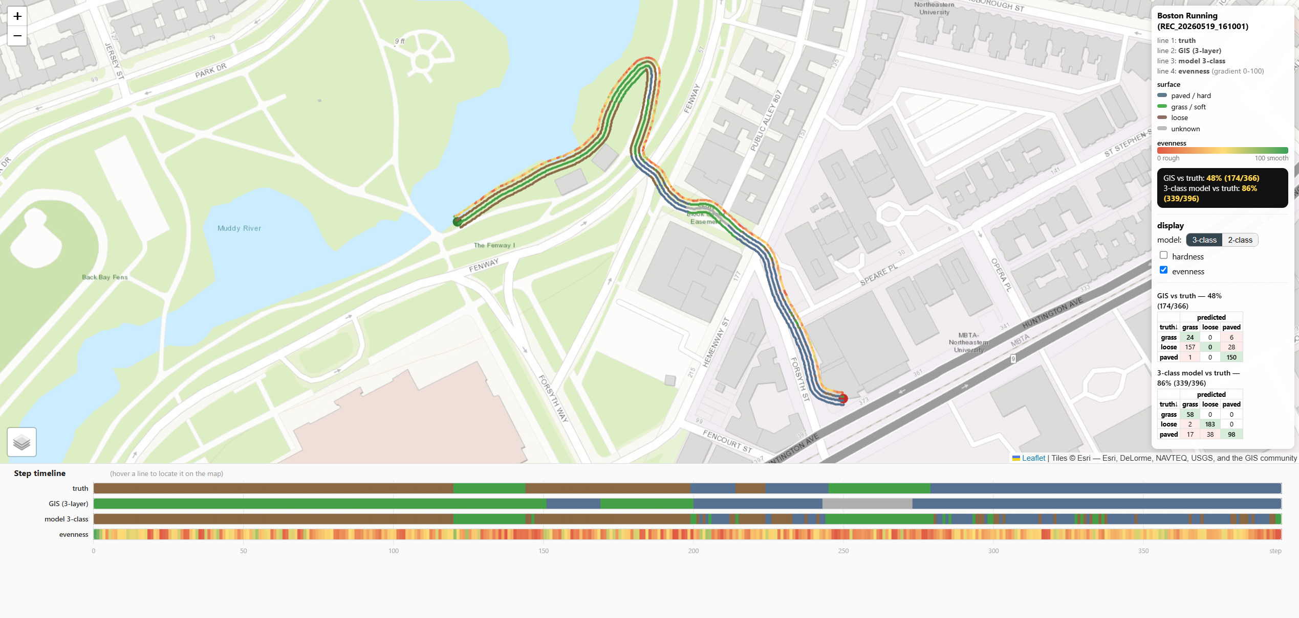
07
VISUALIZATIONS
Seeing it all at once
Per walk, six aligned lines over the route and as a step timeline — ground truth, the GIS map, the 3-class and 2-class predictions, and the evenness & hardness gradients. Hover a line to locate it on the map.
per-walk comparison map + step timeline (REC_20260519_161001)
Notes:
The flagship per-walk comparison map (Screenshot 145345): route with six coloured lines + linked step timeline. Ties the whole pipeline together.

Slide 21
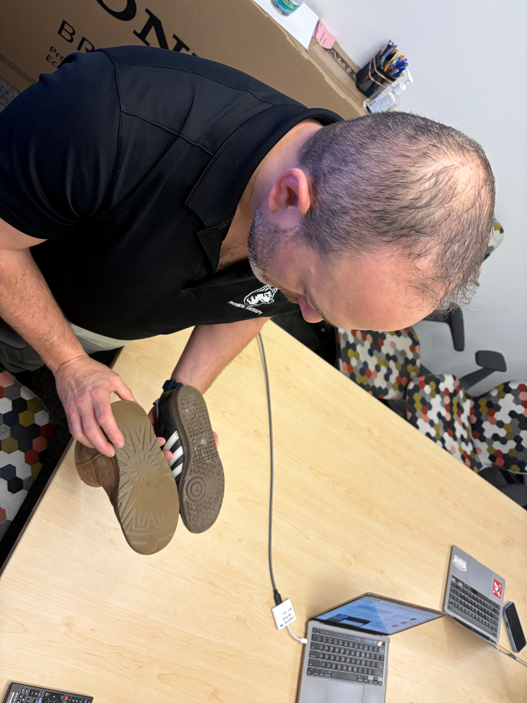
Data Traces
Foot and biomechanics assessment as ground truth
Data traces mark shoe soles based on walking type
Eric Folmar examining walker feet and outsole

Slide 22
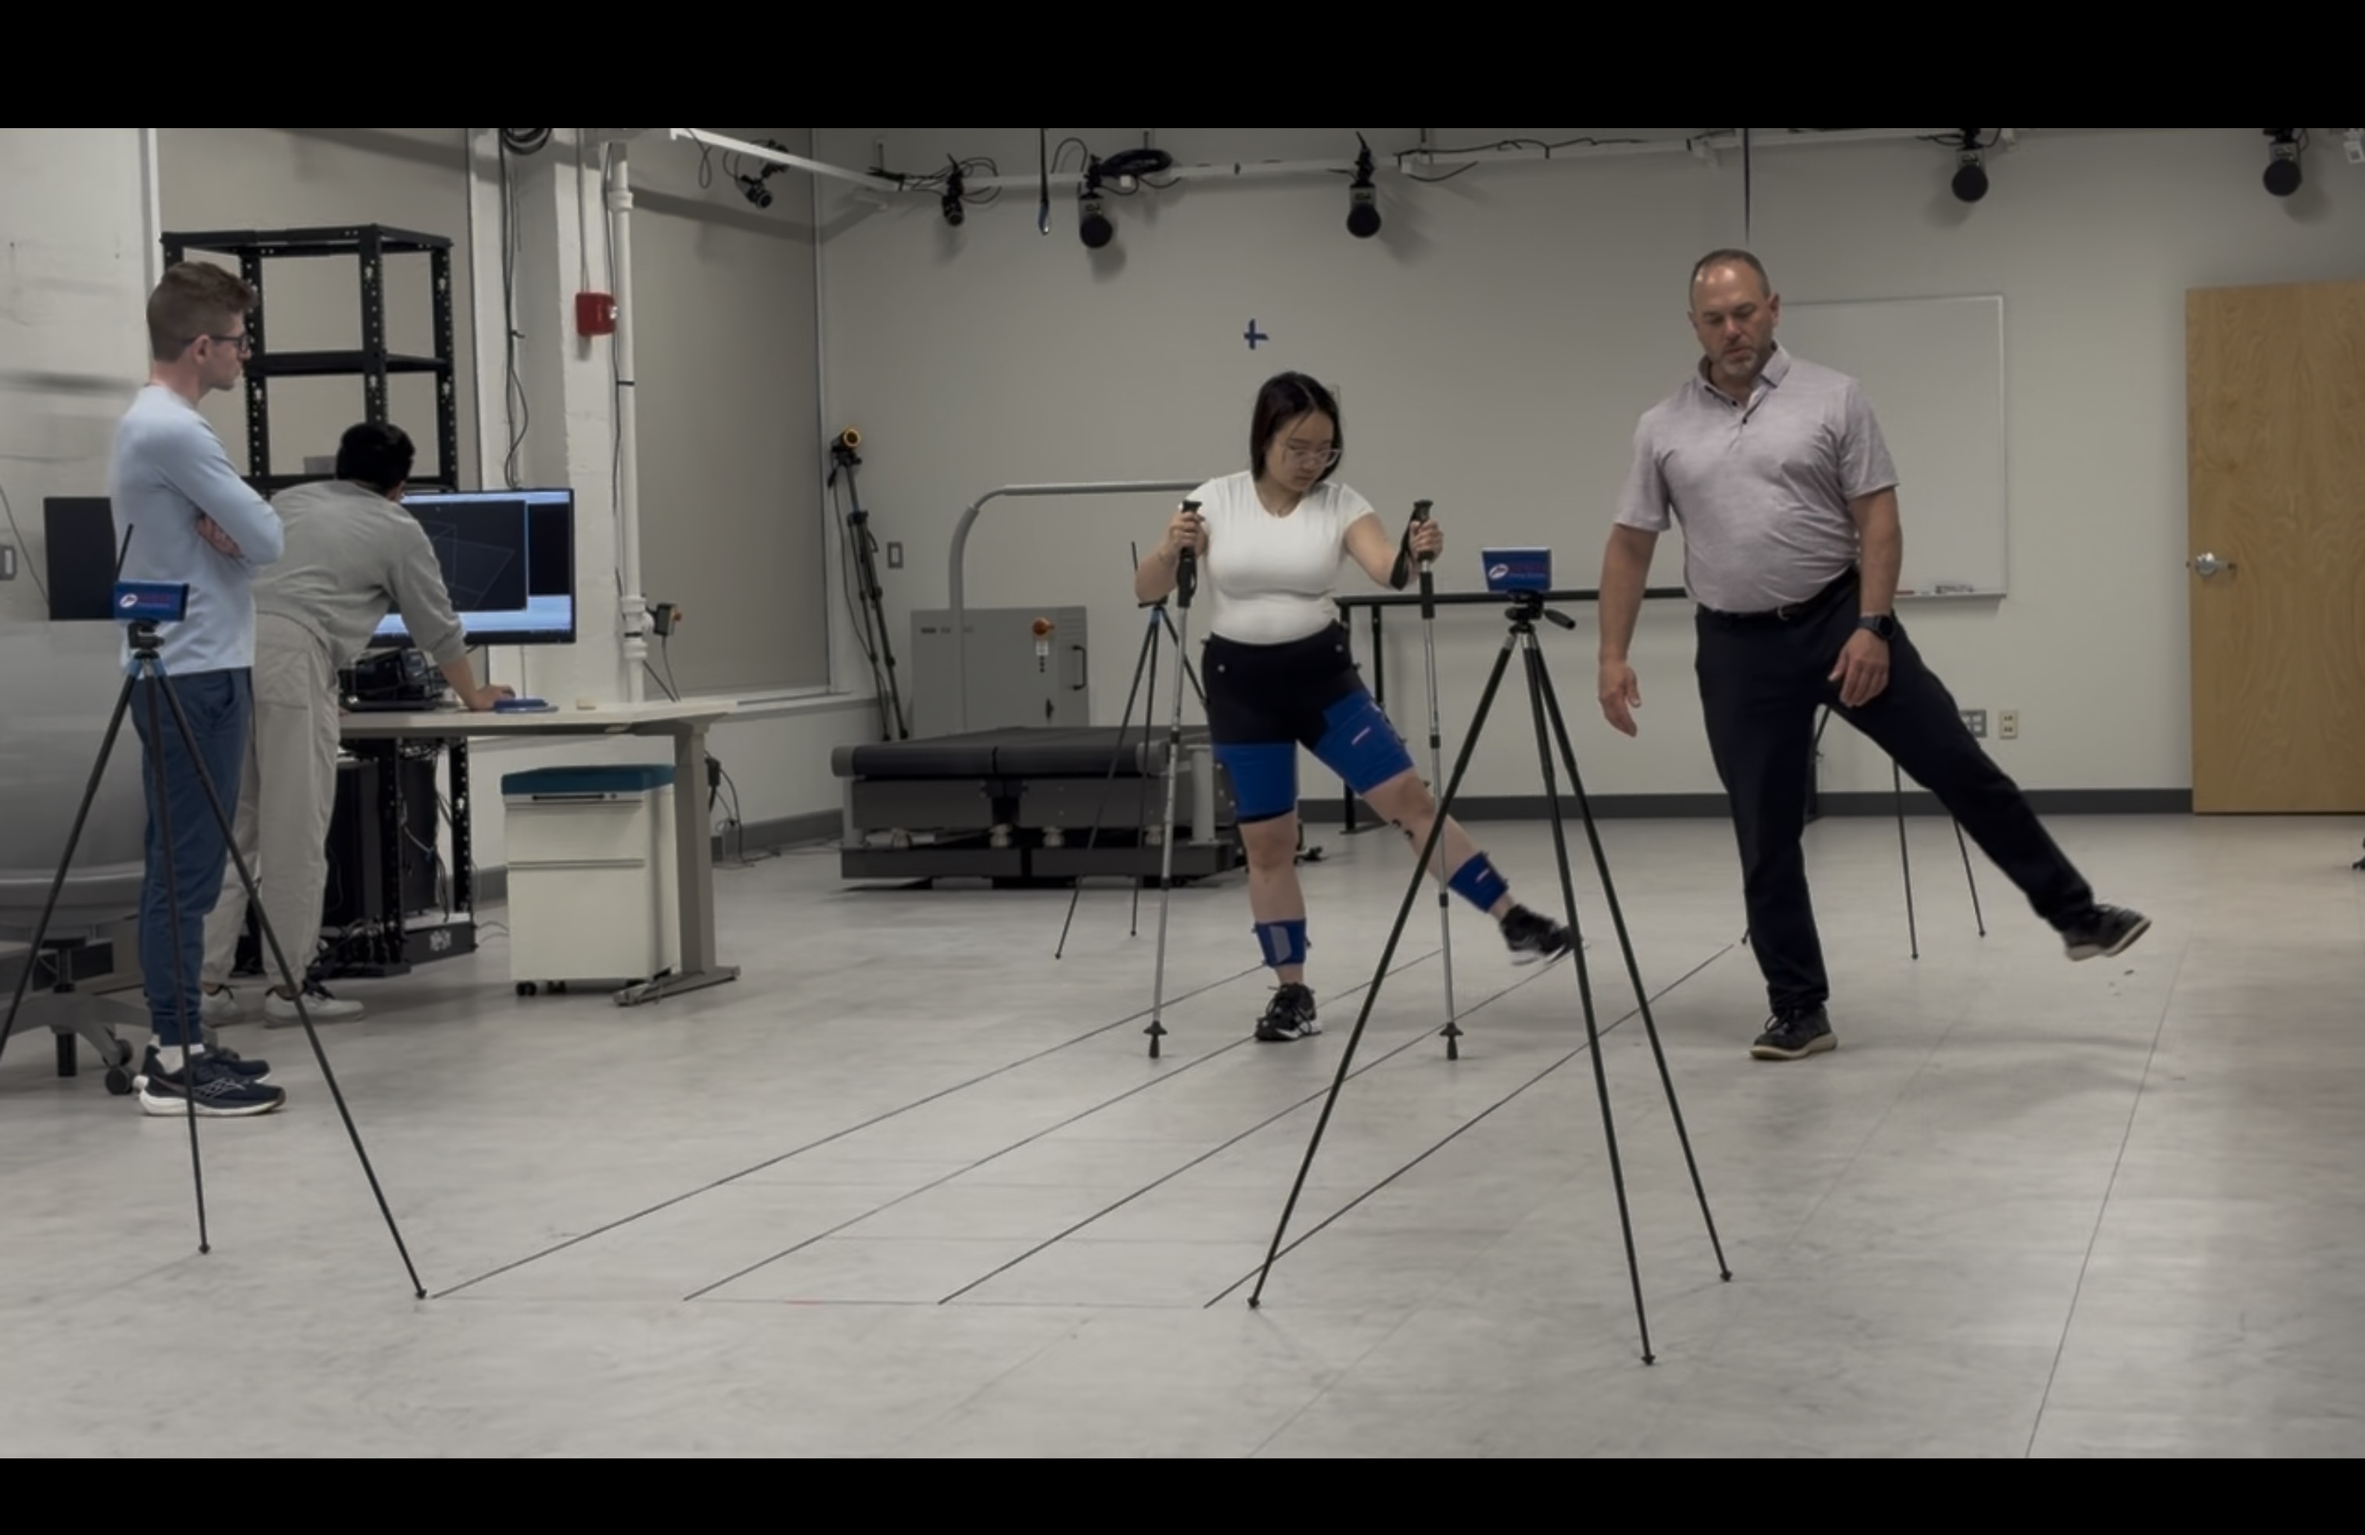
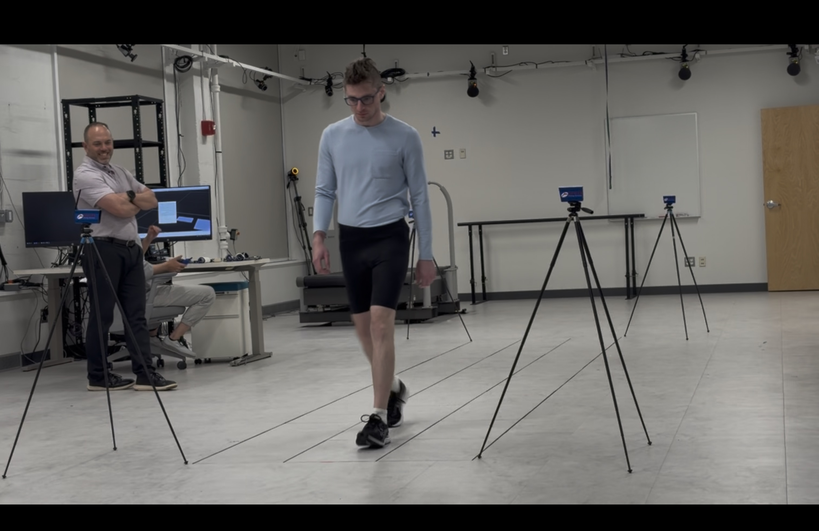
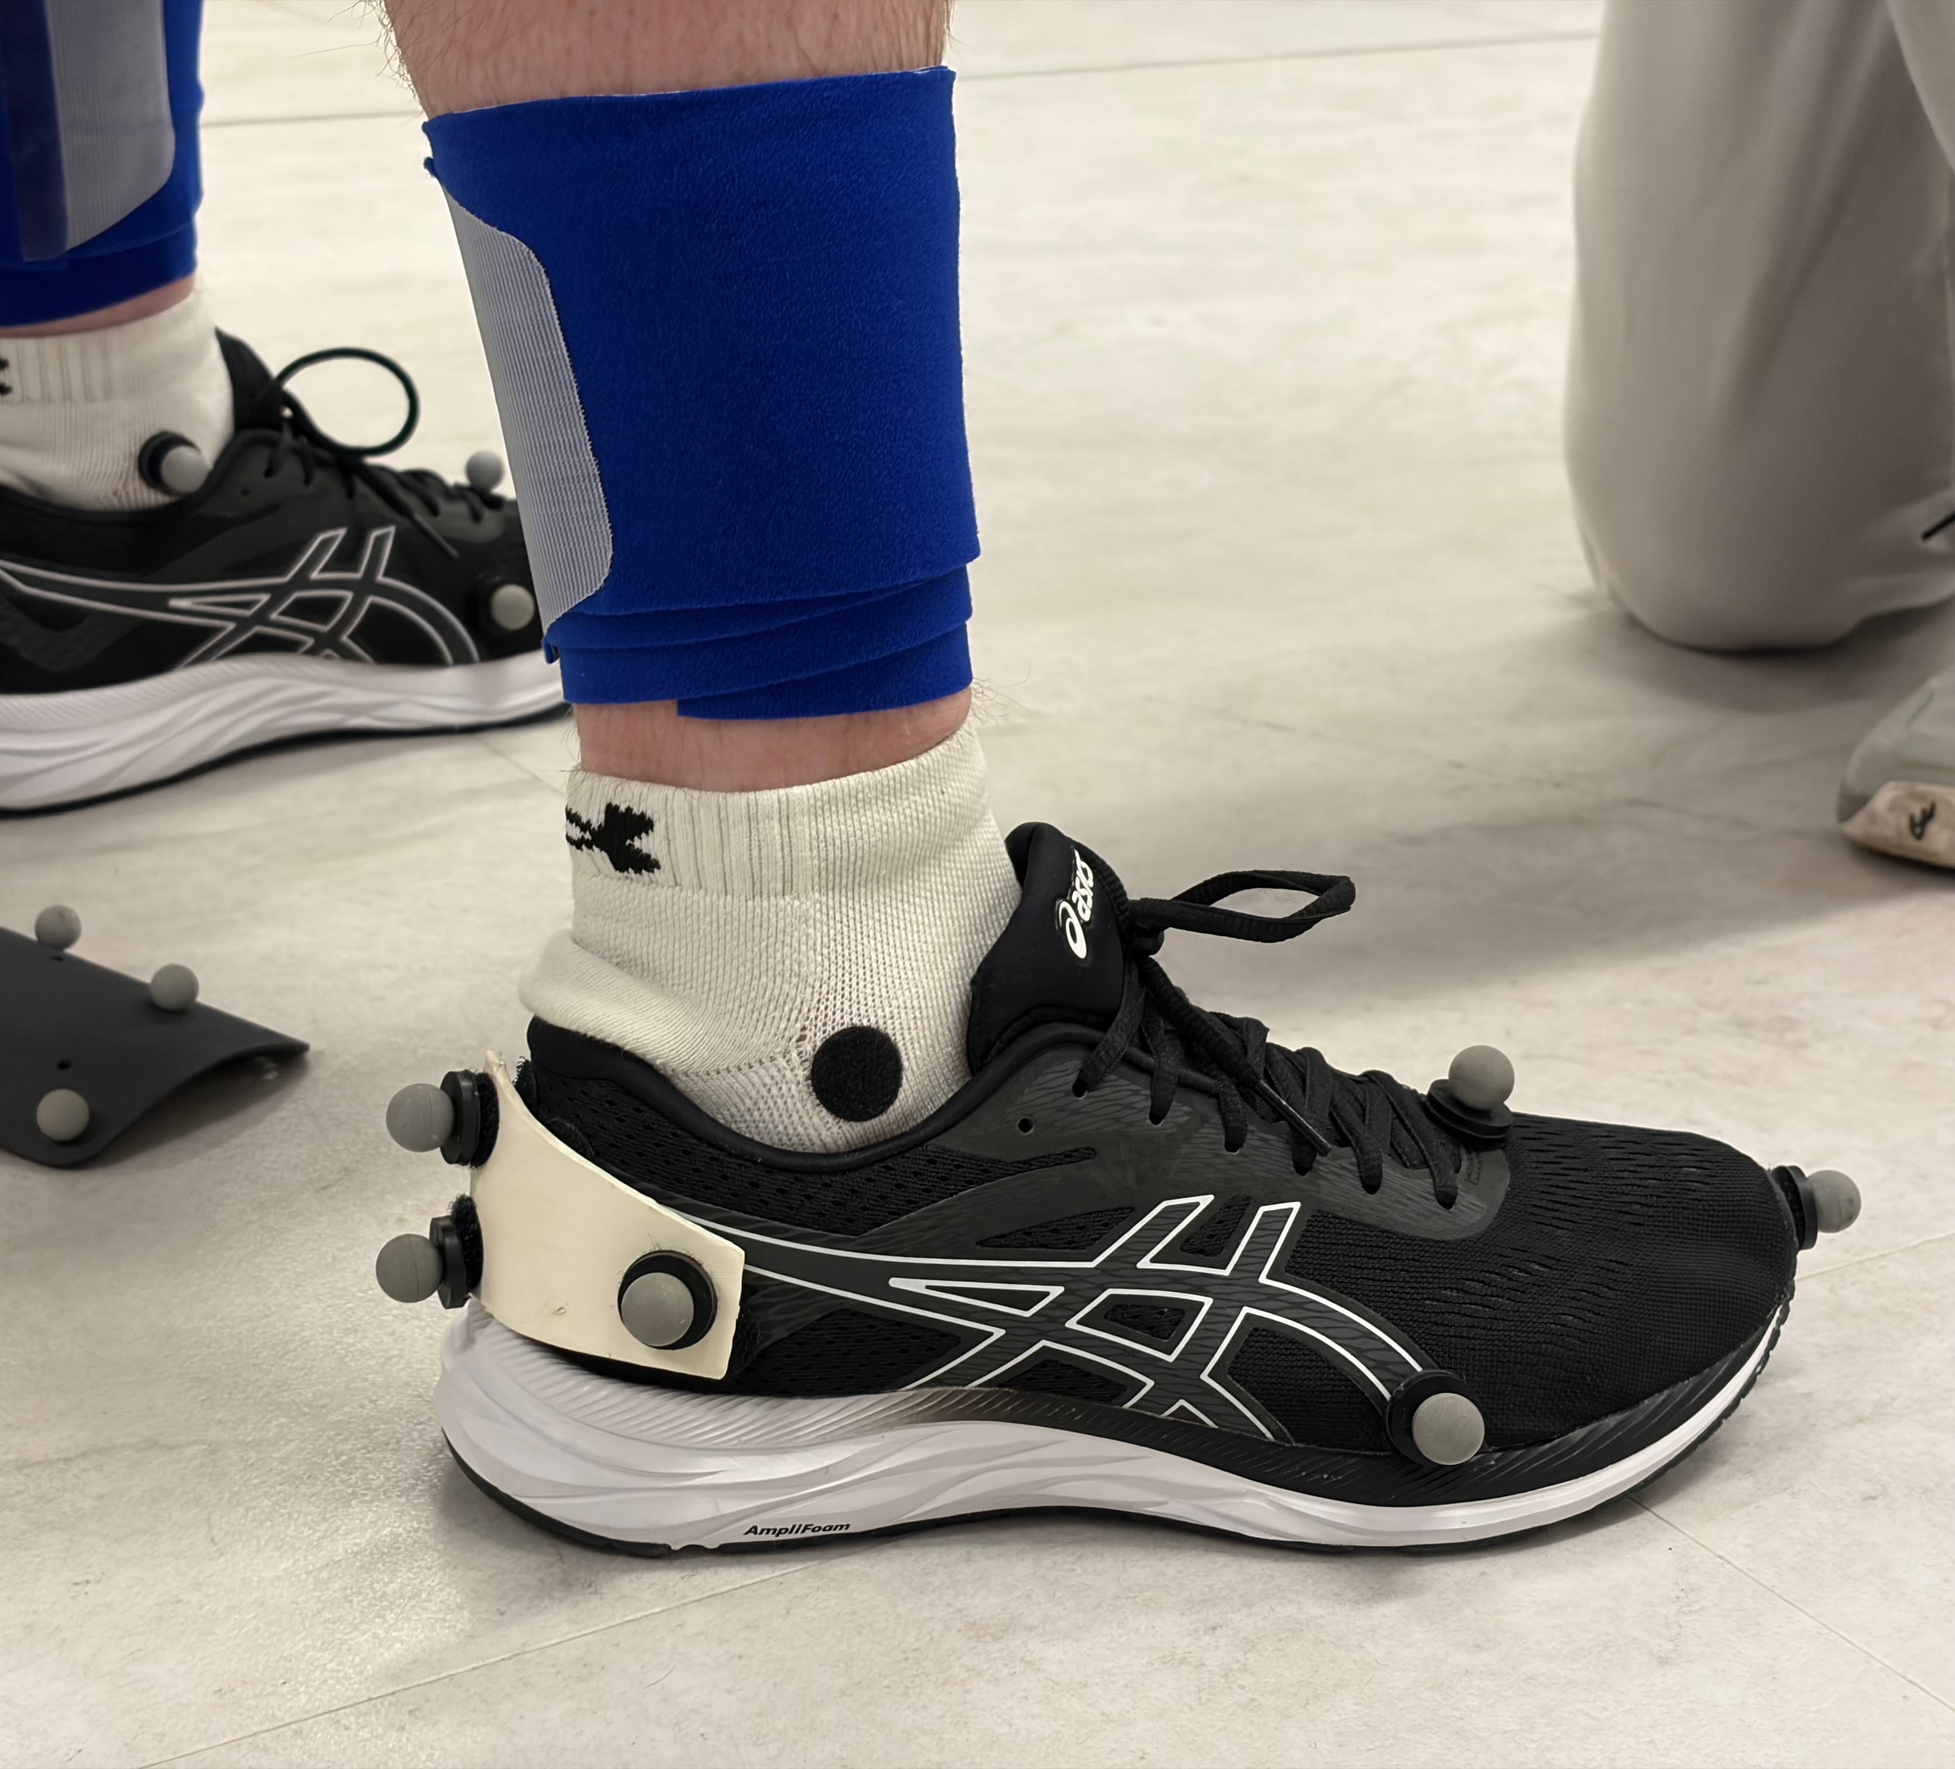
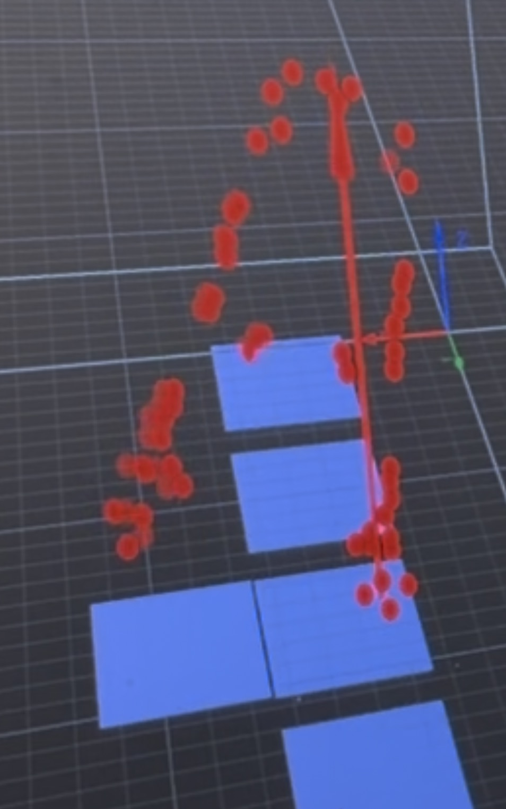
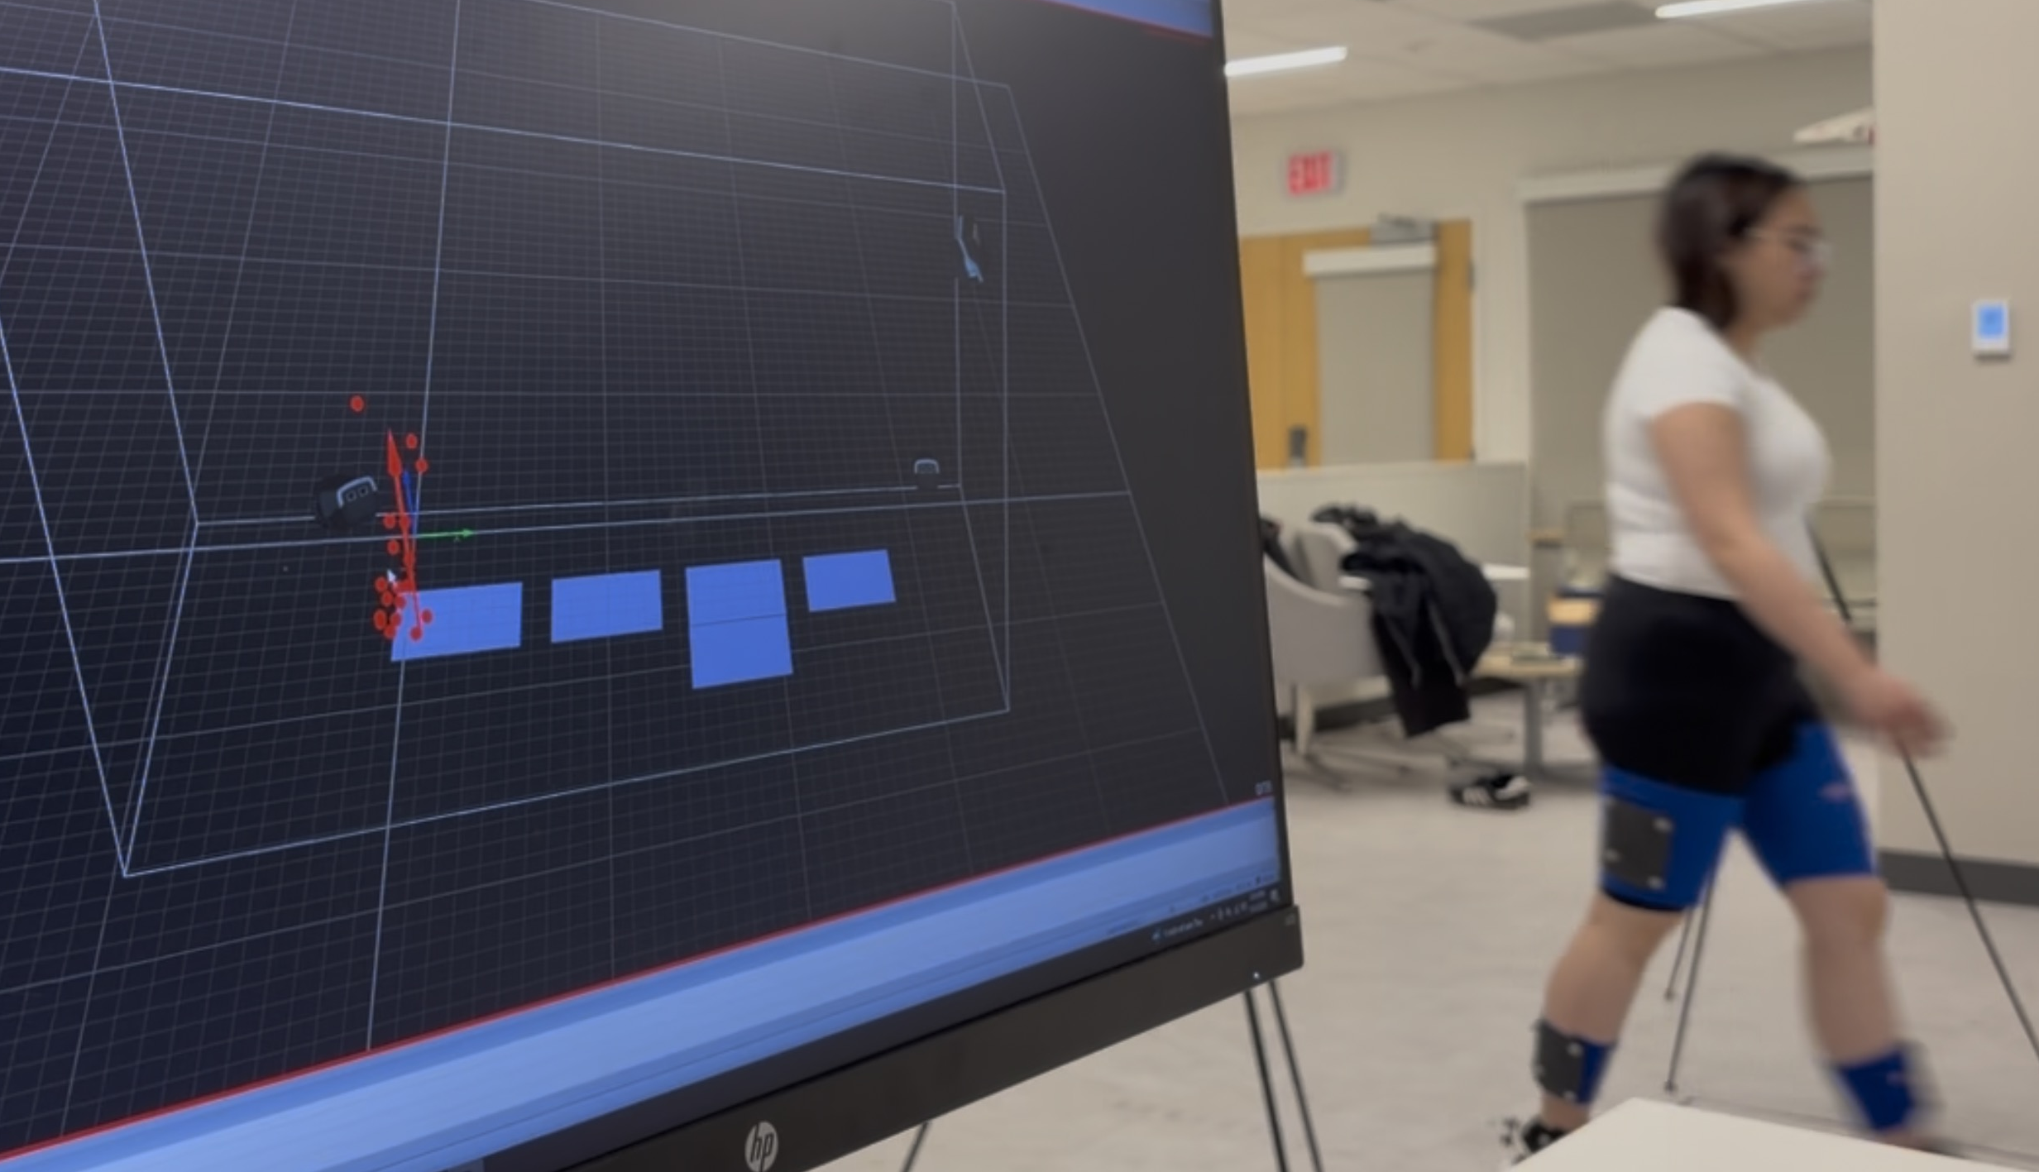
Biomechanics Lab Data Collection

Slide 23
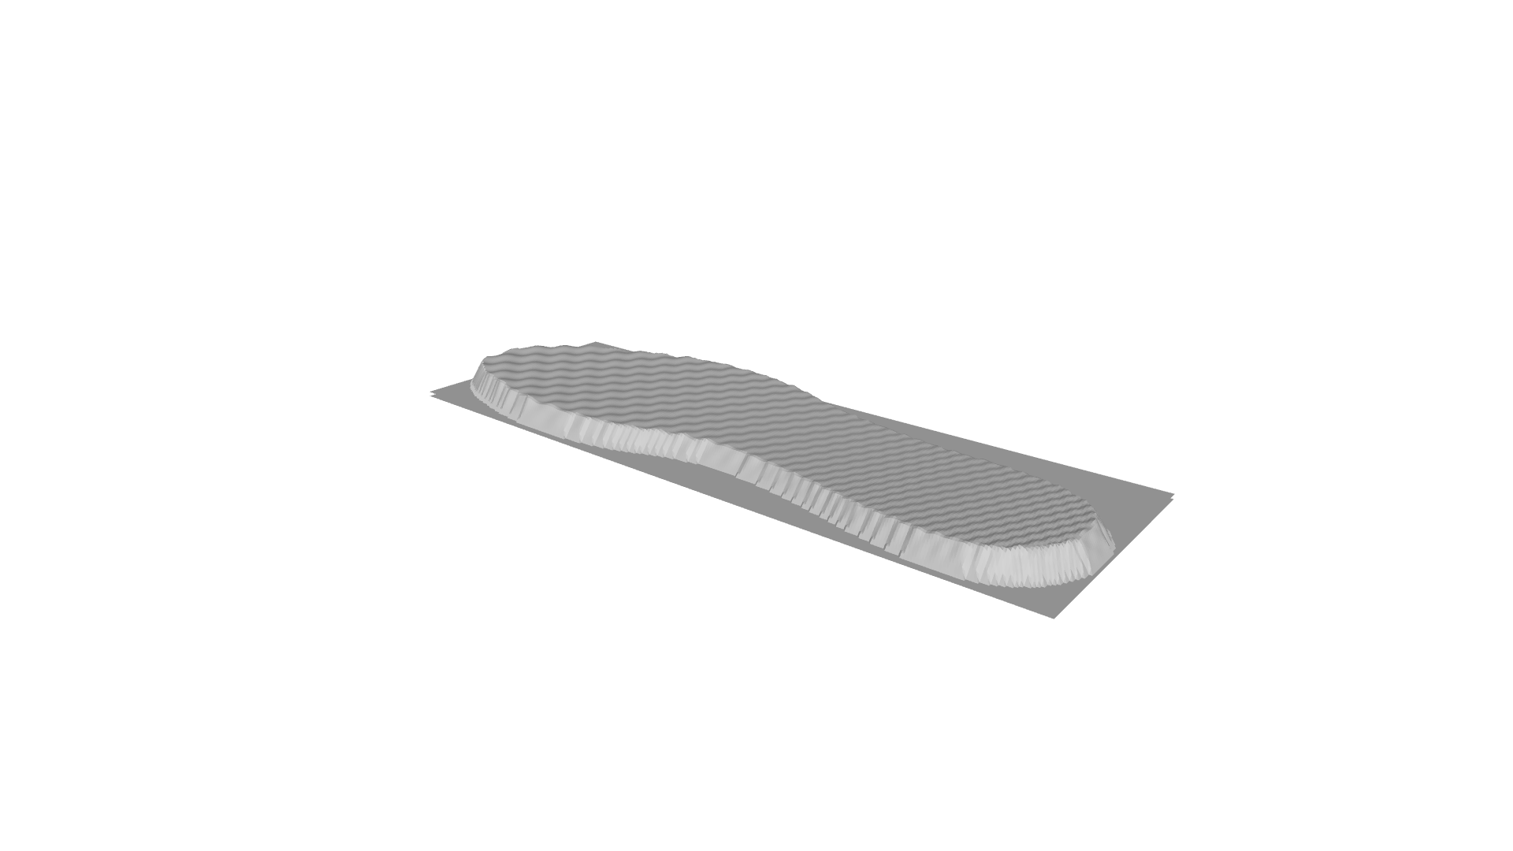
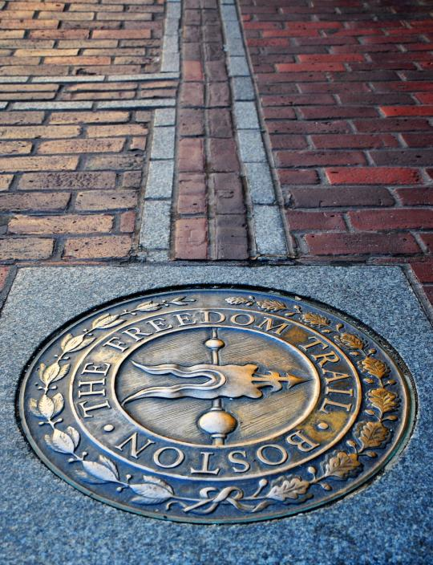



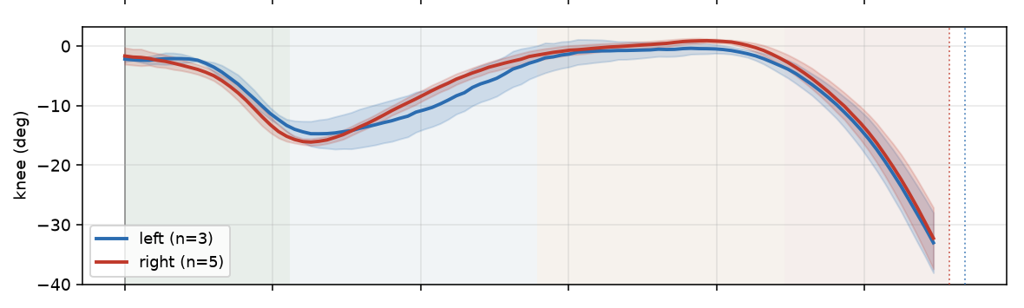
What’s next
1
Physicalization
A tactile 3D 'ground print' comparing how an uneven route feels vs. an even one.
4
Freedom Trail proof-of-concept
Multiple users walk the same route; compare their steps to each other and to GIS.
2
More 4th-class data
Build each user to ~750–850 steps on modular paved (cobblestone/uneven brick).
5
Paper — ACM IMWUT
Target a submission to IMWUT, deadline November 1.
3
More data from Samantha
Grow her step count — friendly step-count competition between walkers encouraged.
6
Walking-type research
Whether an individual's walking style shapes their pressure data & tendencies across surfaces.
Notes:
Retitled What’s next. Future directions: dataset growth (4th class + new surfaces + walkers), better ground truth than GIS, and the health/walkability aims.

